Slide 1

Locaguide
LOCAL TRAVEL EXPERT

Slide 2


Problem Statement
Tourists often miss out on authentic local experiences while traveling alone, highlighting the need for a solution that connects them with knowledgeable local guides to enhance and enrich their overall travel experience.

Slide 3

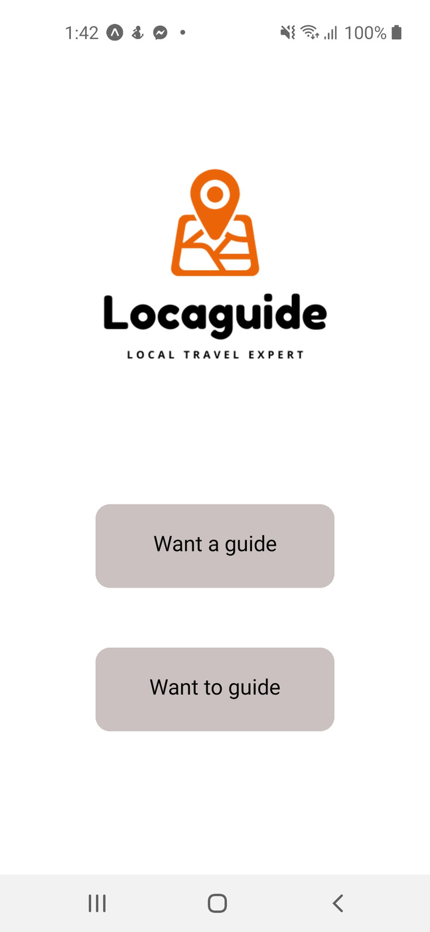
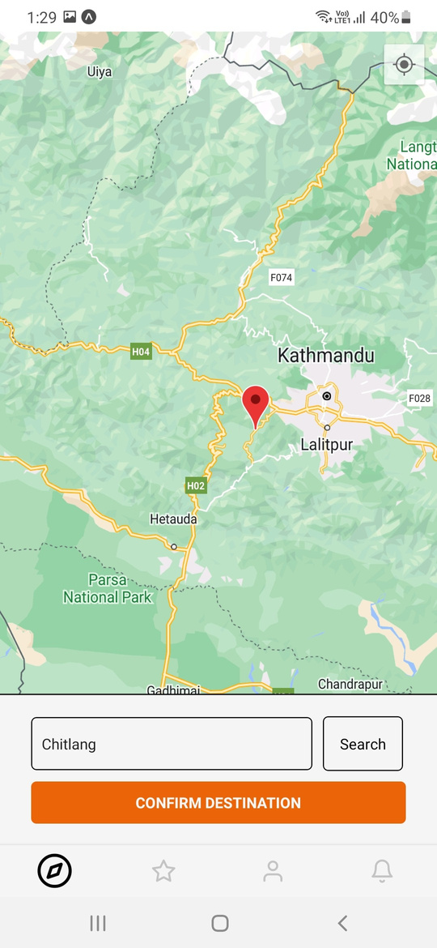
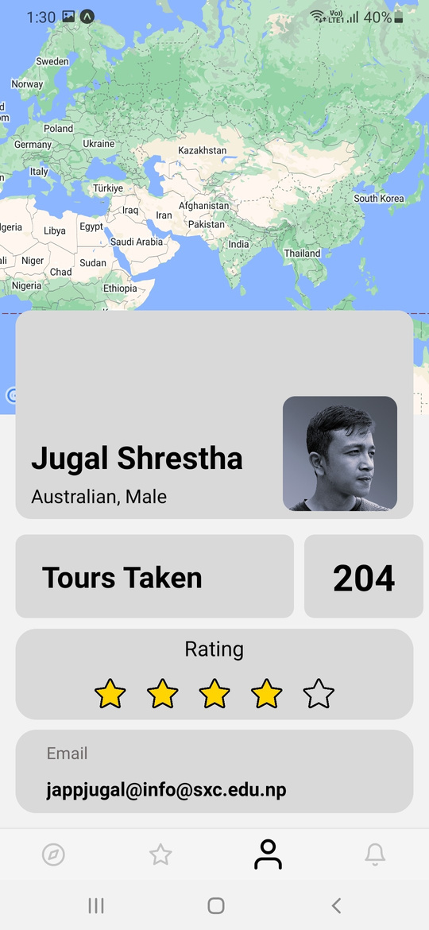
Introduction
LOCAGUIDE: Local Travel Expert
An app, designed for tourists to enhance travel experiences by seamlessly connecting users with local guides for personalized exploration and prioritizing safety through an SOS messaging system, redefining how tourists navigate and enjoy new destinations.

Slide 4

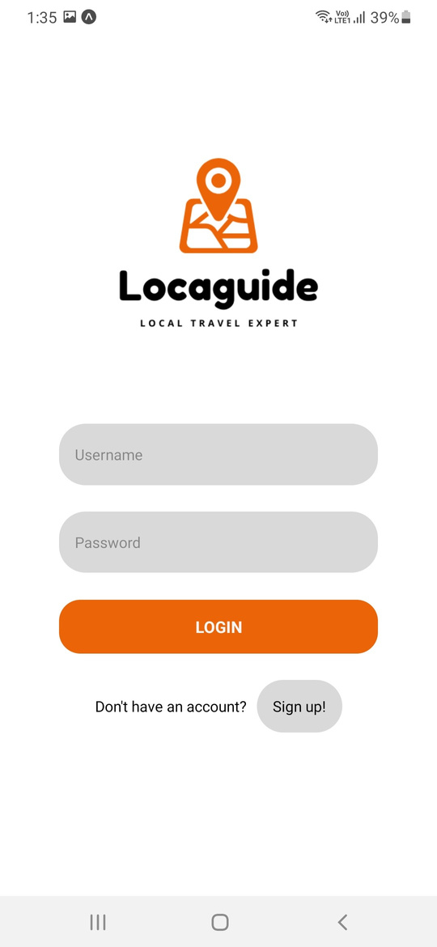
Demonstration

Slide 5
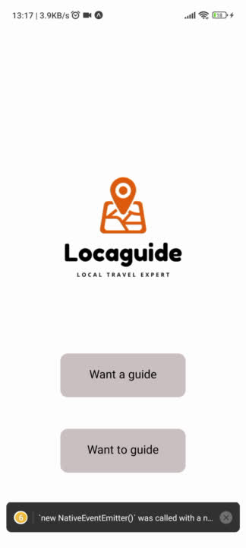
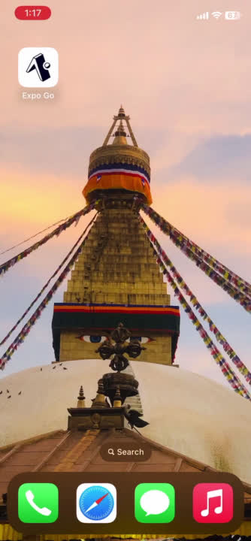
Tourist: Jugal
Guide: Pratyoosh

Slide 6
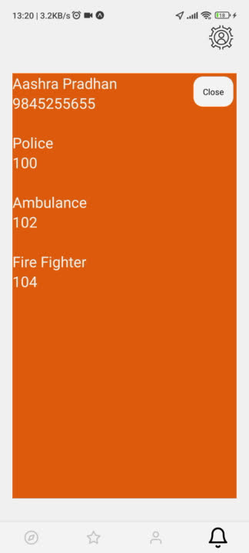
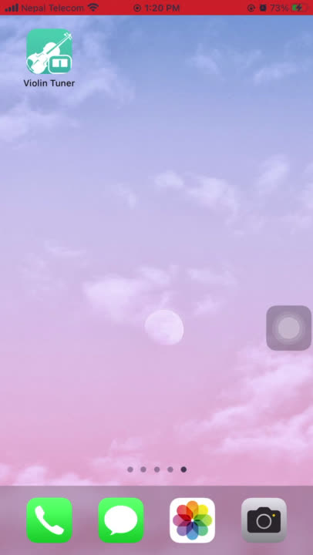
Tourist: Jugal
Emergency Contact : Aashra

Slide 7

Size of The Market
Total Available Market (TAM)
US $ 1 Trillion
The global tourism industry holds an estimated value of $ 1 trillion in 2022.
Total Available Market (TAM)
Serviceable Available Market (SAM)
US $ 146 Million
The Nepalese tourism industry generates estimated annual revenue of $146 million.
Serviceable Available Market (SAM)
Serviceable Obtainable Market (SOM)
US $15 Million
Serviceable Obtainable Market (SOM)
An estimated of 10% revenue from the tourism industry is generated by tour guides. With that calculation we’ll have an SOM of approx $15 million.

Slide 8
Business Model Canvas
Key Partners
Whom will we work with to run the business?
Tourist Guides Hotels Local Communities Emergency Services
Key Activities
What are the tasks and activities to keep our work running every day?
App Development User Testing Guide Tracking Marketing and Promotion Data Privacy and Security Partnership Management Customer Support
Value Proposition
What need are we trying to address? What value will our product bring to the target audience?
Tourists: Easy access to local guides Personalized experience Enhanced safety Accessible tourism features Guides: Increased visibility Employment Opportunities Flexible Work Hours Community: Local Business Promotion Community Engagement Sustainable Tourism Practices
Customer Relationships
What relationships will we establish with each customer segment?
Feedback Mechanisms Ratings User Support Community Engagement Personalized Recommendations
Customer Segments
Who is our target market?
Tourists Local Guides Local Businesses Emergency Services Travel Agencies Hotels and Accommodations
Key Resources
What are the tangible and intangible things we will use to make the product?
Development Team User Data Technology Infrastructure Local Partnerships
Channels
Where will our product be available?
App Stores Website Social Media Hotel Chains
Cost Structure
What are the fixed and variable costs of launching our product?
Development Costs Marketing and Promotion Server and Hosting Costs Customer Support Data Privacy and Security Partnership Costs
Revenue Streams
How will we generate income?
Commission from transactions Premium Subscriptions Ad Revenue Partnership and Sponsorship Affiliate Marketing

Slide 9



Thank you
3

